Slide 1
Application of Blockchain Technology in the Voting System
Cryptography

Slide 2
Team Members
Garvit Arora
Adrian Miranda
Akshat Govil
2016B3A70462H
2016B4A70500H
2016B4A70502H

Slide 3
Issues with the current system
Disbelief/Manipulation: Whenever we come across any public elections, we are bound to hear that the elections were tampered with and the results were manipulated to be biased towards one side no matter how fair the process was.
Security/Hacking: With the current electronic system of voting, it is prone to hackers entering the system and manipulating the results.
Authentication Issues: We do not have a solid authentication process currently which is the core part of blockchain technology.
Errors: With the traditional ballot system, there can be human errors possible as well.

Slide 4
How blockchain technology can help?
Disbelief/Manipulation: With a robust blockchain system put in place, a decentralised database will induce confidence in the voters that there is little to no chance of manipulation. This improves transparency.
Security/Hacking: Mining the blockchain can keep hackers away and increase security. The hash changes with every edit in the block making it very difficult to crack.
Authentication Issues: The authenticity of every vote can be cross-checked with the the database and zero knowledge proof can be used for authentication
Errors: With the blockchain technology, every record can easily be traced leading to no errors.

Slide 5
Layout
Voter Info.
ID
Vote Casted
createBlock()
ID matched in blockchain
No duplicate vote
verifyTransaction()
Security check via hash of neighboring blocks in chain.
mineBlock()
Transaction info of voter with corresponding ID.
viewUser()

Slide 6
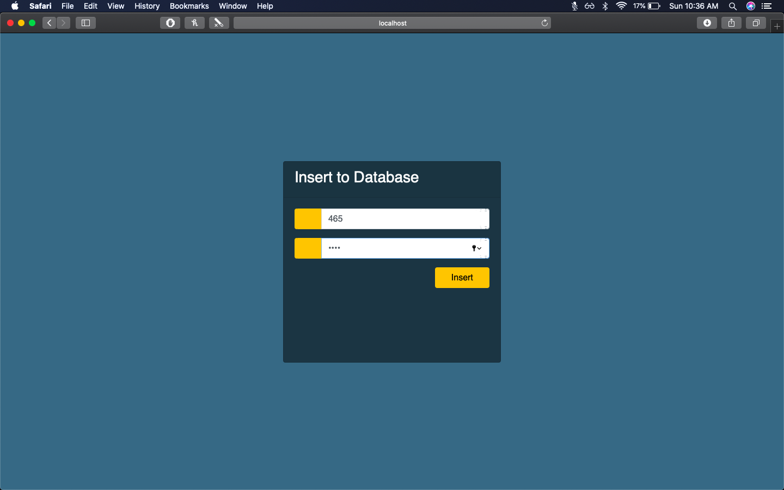
Insert Page: Here the user chooses a voterID and password in order to express his voting rights. Once the data is entered, it is added into our database.

Slide 7
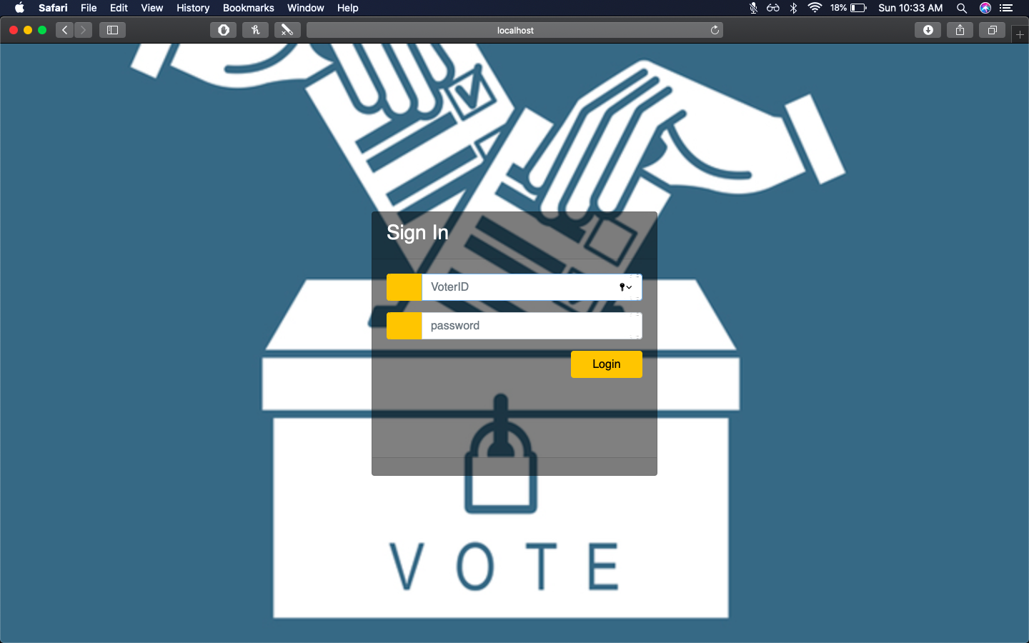
Login Page: Based on the information added to the database, the user logins into the system in order to vote for the desired party.

Slide 8
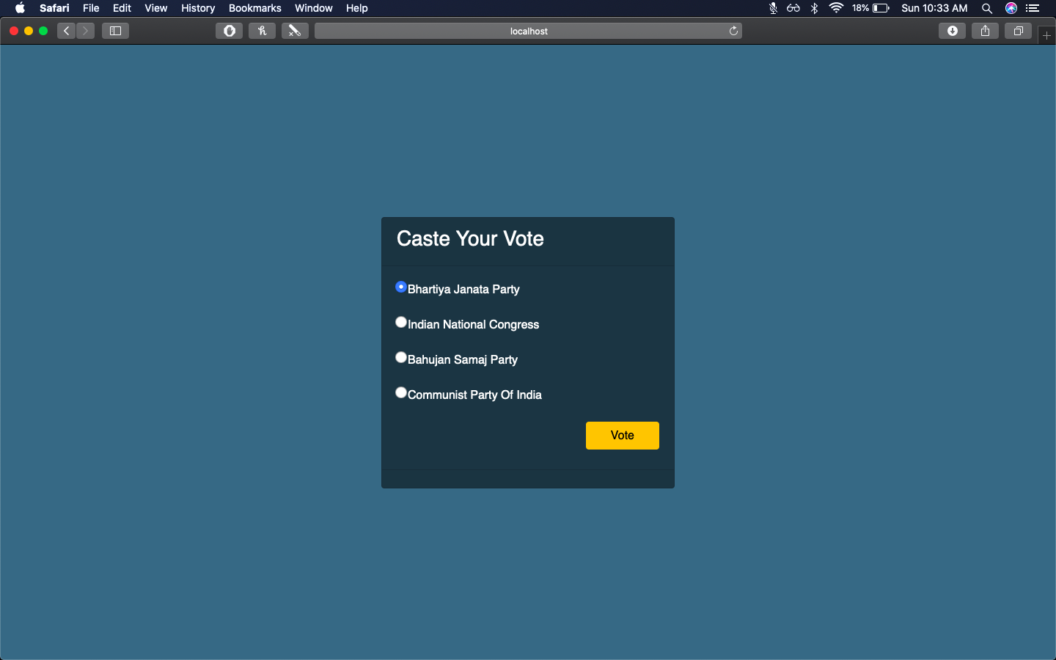
Voting Page: Once the user is logged in, he has the right to vote for the desired party. Once a user votes he can’t change his vote.

Slide 9
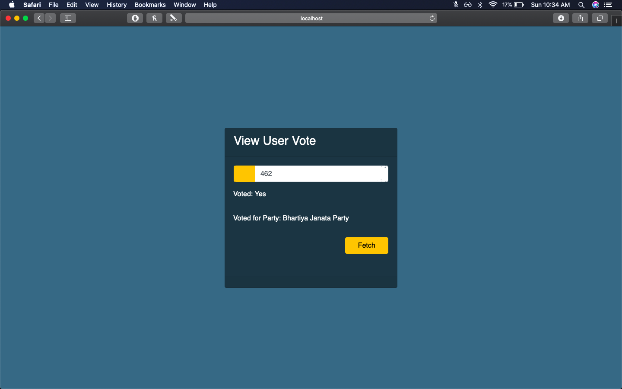
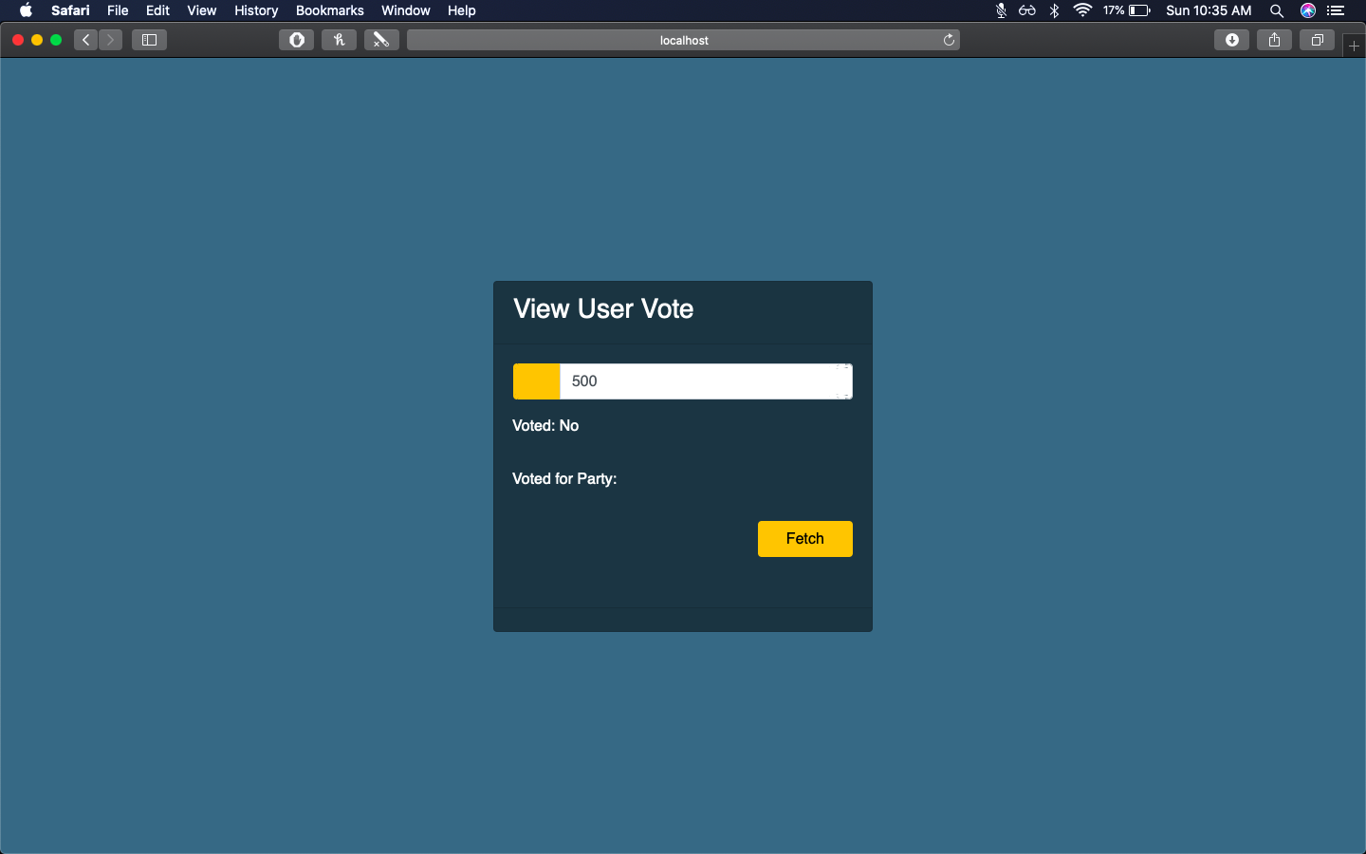
Image 1
Image 2
View User Page:
Image 1 shows us that once the user has voted, his vote can be viewed - including the arty he voted for.
Image 2 shows us that user 500 hasn’t cast his vote yet and hence has no information to show.

Slide 10

Once a particular user casts his vote, no other user can be added into the database, otherwise the integrity of the blockchain is lost. If anyone tries to do so, the voting system doesn’t allow anymore voting as the database has been tampered.

Slide 11


If a user has already voted, he is not allowed to change or cast another vote.
The page displayed once the user has finished voting.

